Slide 1
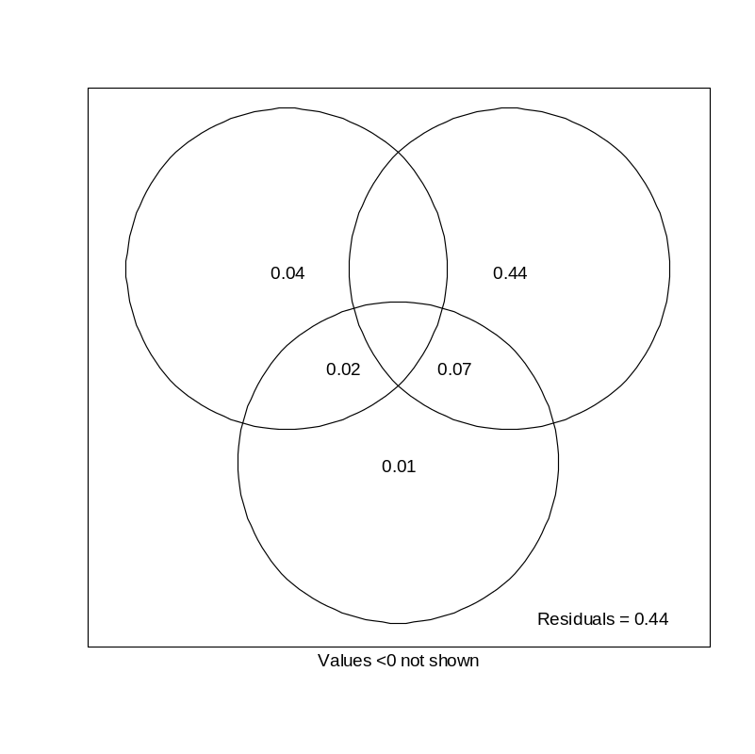
RDA Varpart (adj r2)
CCA Varpart % intertia
B.
Y ∩ S | D
4.4
0.6
48.9
Y | S&D
S | Y&D
8.1
-2.2
7.7
Y ∩ D | S
S ∩ D | Y
1.9
D | S&Y
S ∩ D ∩ Y
Total inertia = 1.476
63% of the of inertia explained

Slide 2
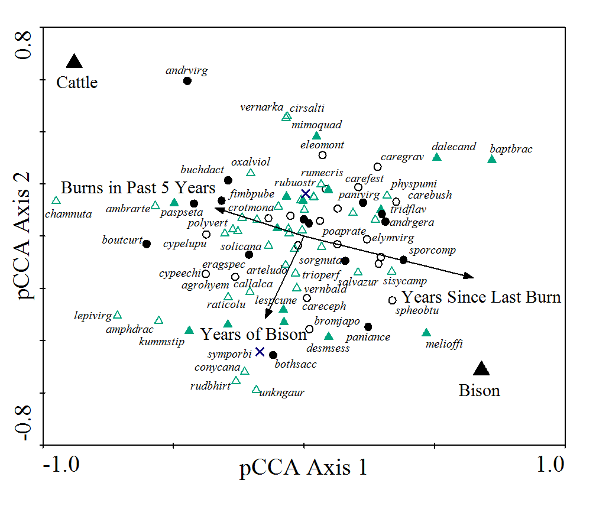
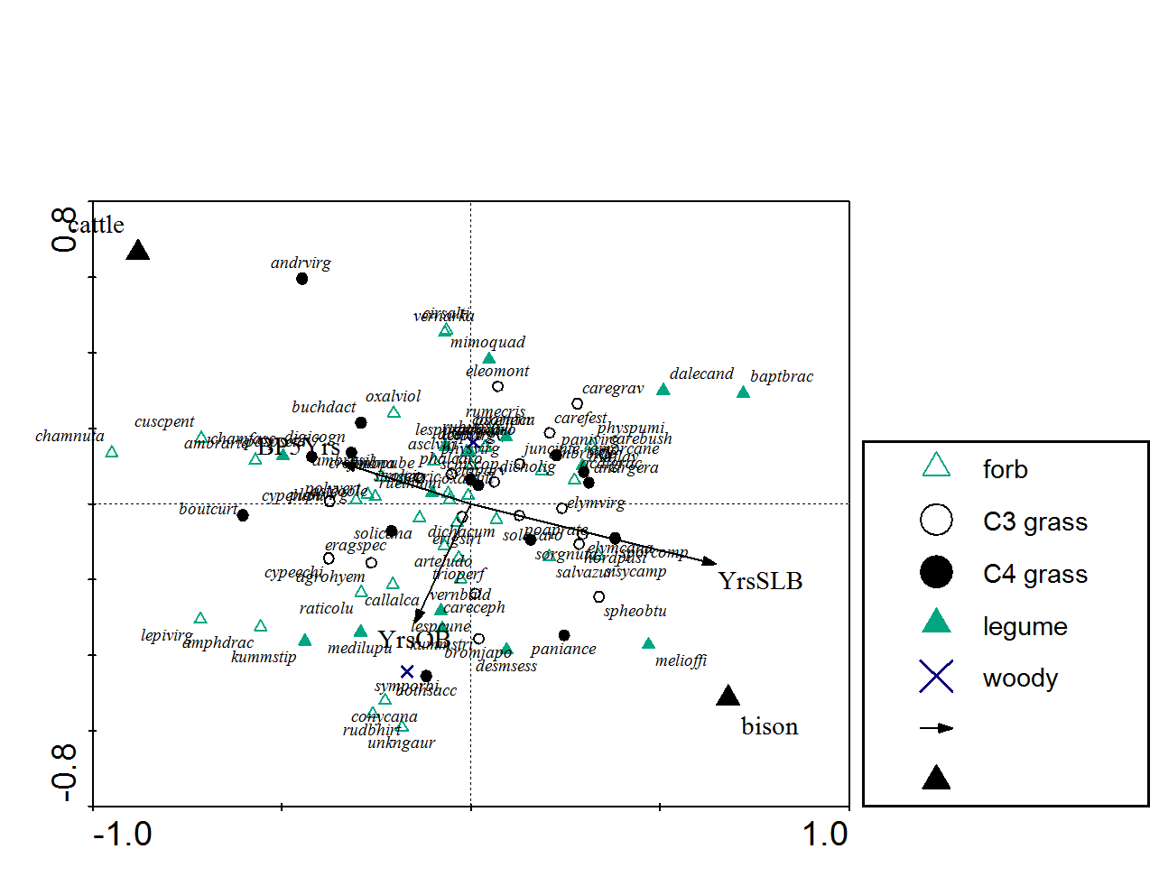
Forb
Legume
C3 graminoid
C4 graminoid
Shrub
Dummy variable
Continuous variable

Slide 3
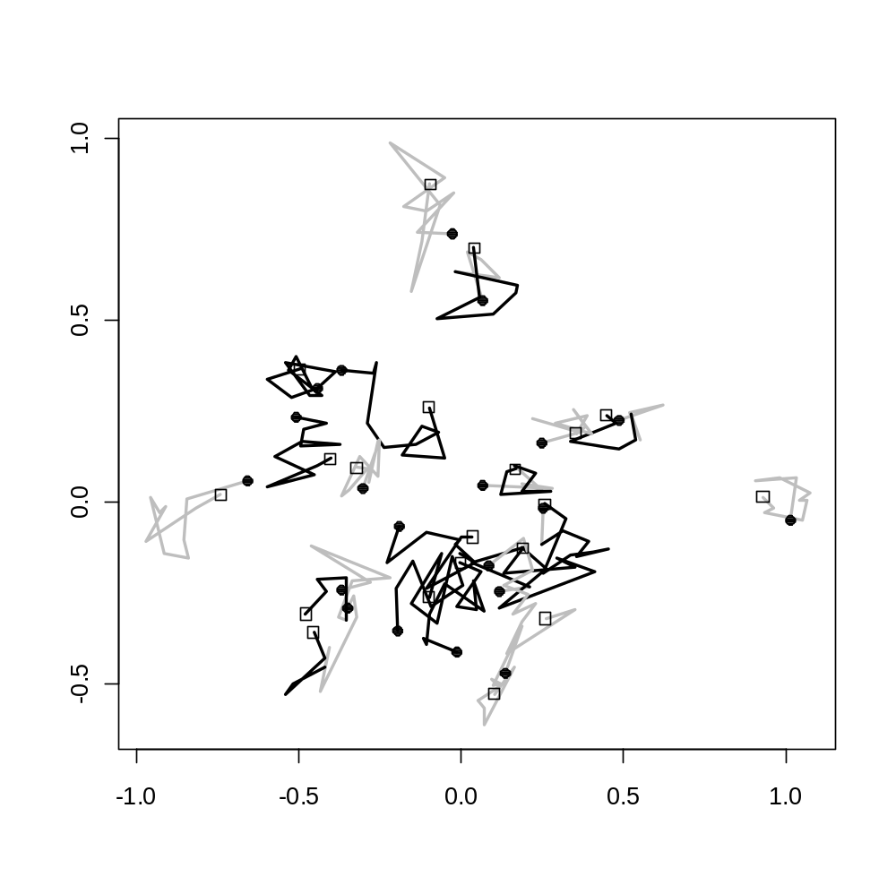
Cattle grazed
Bison grazed
First year (1998)
Last year (2008)
DCA Axis 2
DCA Axis 1

Slide 4
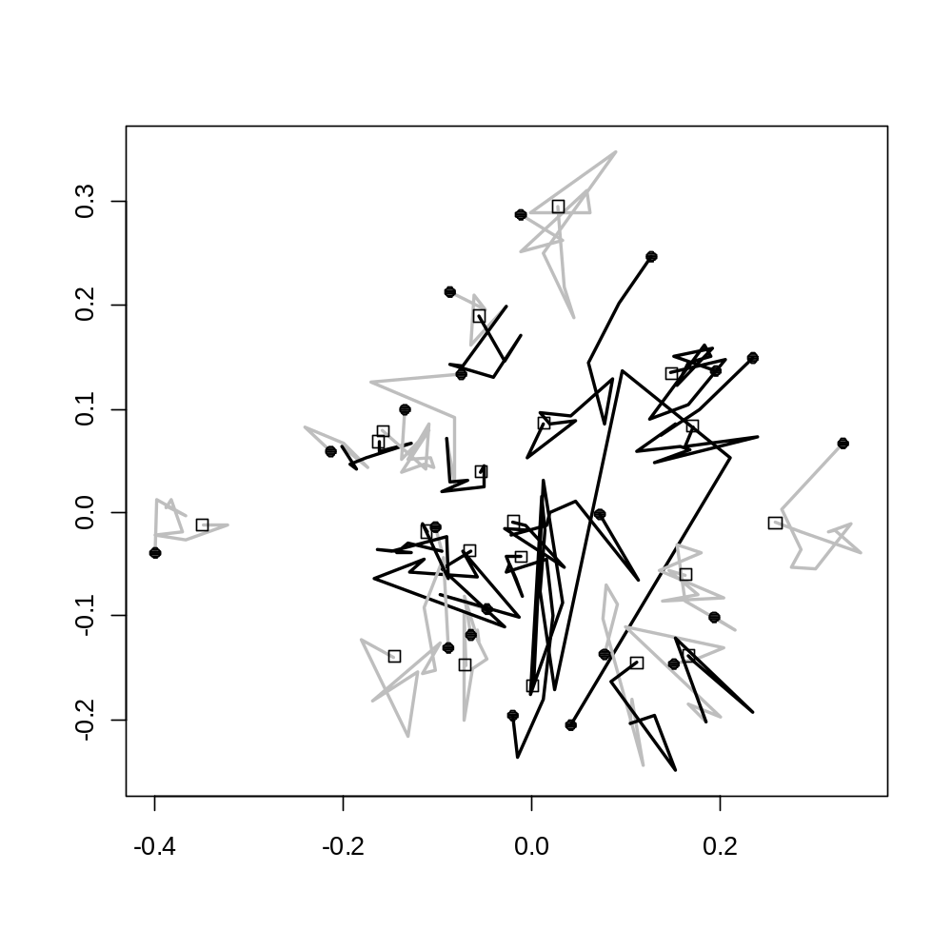
Bray-Curtis dist metric
Cattle grazed
Bison grazed
First year (1998)
Last year (2008)
NMDS Axis 2
NMDS Axis 1
Notes:
--I did not examine if this was the best nmds just the first one that converged, the function in vegan
metaMDS can help to do this if we want

